Slide 1


Slide 2
Q1.Your first priority is to get 2-3 players with high S.R who have faced at least 500 balls.And to do that you have to make a list of 10 players you want to bid in the auction so that when you try to grab them in auction you should not pay the amount greater than you have in the purse for a particular player.
Query-
select
distinct batsman , SUM(batsman_runs) as total_run_score ,count(ball) as total_ball_faced,
ROUND ((SUM(batsman_runs) * 1.0 / count(ball) * 100),2) as batsman_strikerate
from iplball
where extras_type Not in ('wides')
group by batsman
having count(ball) >=500
order by batsman_strikerate desc limit 10;

Slide 3
TOP TEN PLAYER WITH HIGHEST STRIKE RATE
batsman | total_run_score | total_ball_faced | batsman_strikerate
AD Russell | 1517 | 832 | 182.33
SP Narine | 892 | 543 | 164.27
HH Pandya | 1349 | 847 | 159.27
V Sehwag | 2728 | 1755 | 155.44
GJ Maxwell | 1505 | 973 | 154.68
RR Pant | 2079 | 1368 | 151.97
AB de Villiers | 4849 | 3192 | 151.91
CH Gayle | 4772 | 3179 | 150.11
KA Pollard | 3023 | 2017 | 149.88
JC Buttler | 1714 | 1146 | 149.56

Slide 4
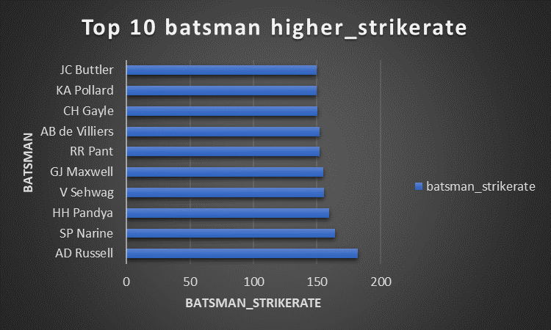
Graph chart of Top Ten batsman with highest strike rate

Slide 5
Q2.Now you need to get 2-3 players with good Average who have played more the 2 ipl seasons.And to do that you have to make a list of 10 players you want to bid in the auction so that when you try to grab them in auction you should not pay the amount greater than you have in the purse for a particular player
Query-
select
distinct batsman,
sum(batsman_runs) as total_run,
count(distinct id) as match_played,
sum(is_wicket) as total_out ,
ROUND(sum(batsman_runs) * 1.0 / sum(is_wicket),2) as avg_score
from iplball
where extras_type Not in('wides')
group by batsman
having count(distinct id)>28
order by avg_score desc limit 10;

Slide 6
TOP TEN PLAYER WITH HIGHEST AVERAGE SCORE
batsman | total_run | match_played | total_out | avg_score
KL Rahul | 2647 | 72 | 62 | 42.69
ML Hayden | 1107 | 32 | 26 | 42.58
AB de Villiers | 4849 | 156 | 114 | 42.54
DA Warner | 5254 | 142 | 126 | 41.7
CH Gayle | 4772 | 131 | 115 | 41.5
JP Duminy | 2029 | 75 | 49 | 41.41
LMP Simmons | 1079 | 29 | 27 | 39.96
KS Williamson | 1619 | 52 | 41 | 39.49
SE Marsh | 2477 | 69 | 64 | 38.7
MEK Hussey | 1977 | 58 | 52 | 38.02

Slide 7
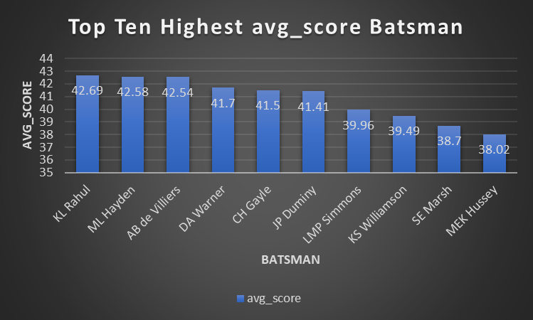
Graph chart of Top Ten batsman with highest average score

Slide 8
Q3.Now you need to get 2-3 Hard-hitting players who have scored most runs in boundaries and have played more the 2 ipl season. To do that you have to make a list of 10 players you want to bid in the auction so that when you try to grab them in auction you should not pay the amount greater than you have in the purse for a particular player.
select batsman, sum(batsman_runs) as Total_run_score ,sum(case when batsman_runs in (4,6) then batsman_runs else 0 end) as boundary,
ROUND((sum(case when batsman_runs in (4,6) then batsman_runs else 0 end) * 100.0) / nullif(sum(batsman_runs), 0), 2) as boundary_percentage
from iplball
where extras_type != 'wides'
group by batsman
having count (distinct id) > 28
order by boundary_percentage desc limit 10;

Slide 9
Top Ten Hard-Hitter Batsman
batsman | total_run_score | boundary | boundary_percentage
SP Narine | 892 | 724 | 81.17
AD Russell | 1517 | 1194 | 78.71
CH Gayle | 4772 | 3630 | 76.07
ST Jayasuriya | 768 | 570 | 74.22
AC Gilchrist | 2069 | 1508 | 72.89
V Sehwag | 2728 | 1972 | 72.29
DR Smith | 2385 | 1682 | 70.52
CA Lynn | 1280 | 890 | 69.53
Harbhajan Singh | 829 | 568 | 68.52
SR Watson | 3874 | 2644 | 68.25

Slide 10
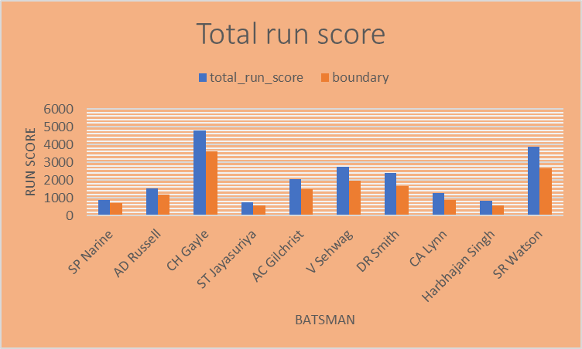
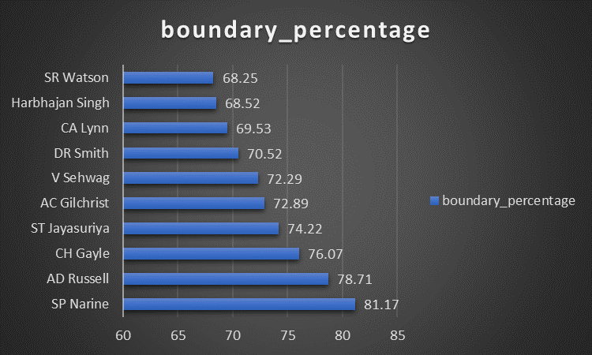
Chart Graph of TOP TEN HARD HITTER BATSMAN

Slide 11
Q4.Your first priority is to get 2-3 bowlers with good economy who have bowled at least 500 balls in IPL so far.To do that you have to make a list of 10 players you want to bid in the auction so that when you try to grab them in auction you should not pay the amount greater than you have in the purse for a particular player.
select bowler,
ROUND(SUM(total_runs)/(COUNT(bowler)/6.0),2) as economy
from iplball
group by bowler
having count(bowler) >=500
order by economy limit 10;

Slide 12
TOP TEN ECONOMY BOWLER
bowler | economy
Rashid Khan | 6.33
A Kumble | 6.65
M Muralitharan | 6.68
DW Steyn | 6.77
R Ashwin | 6.77
SP Narine | 6.82
DL Vettori | 6.83
Washington Sundar | 6.89
J Botha | 6.92
R Tewatia | 6.99

Slide 13
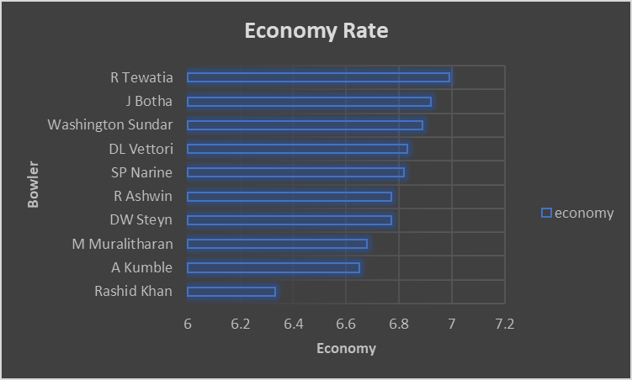
Chart Graph of Top Ten Economy Rate Bowler

Slide 14
Q5.Now you need to get 2-3 bowlers with the best strike rate and who have bowled at least 500 balls in IPL so far.To do that you have to make a list of 10 players you want to bid in the auction so that when you try to grab them in auction you should not pay the amount greater than you have in the purse for a particular player.
WITH ValidDismissals as (
select bowler,is_wicket,
CASE
WHEN dismissal_kind IN ('bowled', 'caught', 'caught and bowled', 'hit wicket', 'lbw', 'stumped')
THEN 1
ELSE 0
END AS is_valid_dismissal
from iplball
)
select bowler,
ROUND(COUNT(bowler) * 1.0 / SUM(is_valid_dismissal),2) as bowling_sr
from ValidDismissals
group by bowler
having COUNT(bowler) > 500
order by bowling_sr asc limit 10;

Slide 15
TOP TEN BEST STRIKE RATE BOWLER
bowler | bowling_sr
K Rabada | 13.77
AJ Tye | 16.13
DE Bollinger | 16.22
Imran Tahir | 16.43
SL Malinga | 17.49
S Aravind | 17.51
MA Starc | 18
YS Chahal | 18.08
KK Cooper | 18.18
TA Boult | 18.29

Slide 16
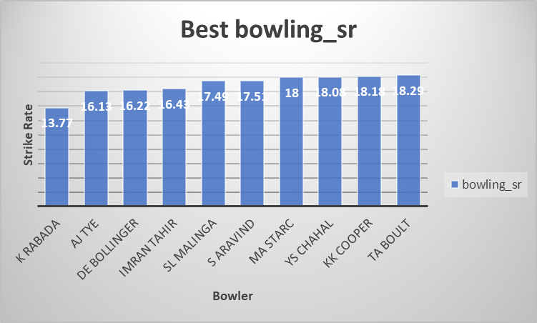
Chart Graph of Top Ten Best Bowling strike rate

Slide 17
Q6.Now you need to get 2-3 Hard-hitting players who have scored most runs in boundaries and have played more the 2 ipl season. To do that you have to make a list of 10 players you want to bid in the auction so that when you try to grab them in auction you should not pay the amount greater than you have in the purse for a particular player.
WITH BatsmanStats as (
select batsman,
ROUND((SUM(batsman_runs) * 1.0 / COUNT(ball) * 100), 2) as batsman_strikerate,
COUNT(ball) as balls_faced
from iplball
where extras_type NOT IN ('wides')
group by batsman
having COUNT(ball) > 500
),
BowlerStats as (
WITH ValidDismissals as (
select bowler, is_wicket,
CASE
WHEN dismissal_kind IN ('bowled', 'caught', 'caught and bowled', 'hit wicket', 'lbw', 'stumped')
THEN 1
ELSE 0
END as is_valid_dismissal
from iplball
)

Slide 18
select bowler,
CASE
WHEN SUM(is_valid_dismissal) = 0 THEN 0
ELSE ROUND(COUNT(bowler) * 1.0 / SUM(is_valid_dismissal), 2)
END as bowling_strikerate,
COUNT(bowler) as balls_bowled
from ValidDismissals
group by bowler
having COUNT(bowler) >=300
)
select
BatsmanStats.batsman,
BatsmanStats.batsman_strikerate,
BowlerStats.bowling_strikerate
from
BatsmanStats
JOIN BowlerStats ON BatsmanStats.batsman = BowlerStats.bowler
order by
BatsmanStats.batsman_strikerate desc,
BowlerStats.bowling_strikerate asc limit 10;

Slide 19
TOP TEN BEST ALL ROUNDER PLAYER
batsman | batsman_strikerate | bowling_strikerate
AD Russell | 182.33 | 19.44
SP Narine | 164.27 | 22.24
HH Pandya | 159.27 | 21.76
GJ Maxwell | 154.68 | 29.37
CH Gayle | 150.11 | 32.44
KA Pollard | 149.88 | 23.57
ST Jayasuriya | 144.36 | 23.15
YK Pathan | 142.97 | 28.19
KH Pandya | 142.45 | 27.89
JA Morkel | 141.98 | 21.26

Slide 20
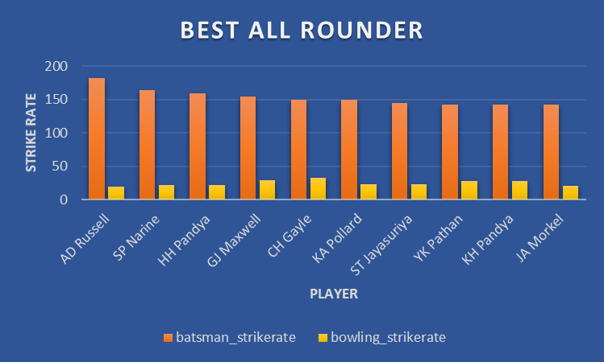
Chart Graph of Top Ten Best All Rounder Player

Slide 21
Try to Find best wicketkeeper required for IPL T20 league under given certain criteria.
1.Best batting strikerate as well as batting average and who have face atleast 500 balls in IPL that player is picked up. Who played well in critical situation according to match condition.
2.Efficient in catching and Stumping.
3.Take Max no of Dismissals behind the stumped as well as Fast reflex action in stumping or runout.
4.Experienced Player Who are more benificial for the team under pressure situation and critical condition.
5.Physical Fitness and mental Fitness both are important for best wicketkeeper role.
6.Player’s Current form or last match played performance is also take care in the consideration.

Slide 22
Additional Questions
Get the count of cities that have hosted an IPL match
select count(distinct city) as total_city
from iplmatch;
total_city
33

Slide 23
Q2.Create table deliveries_v02 with all the columns of the table ‘deliveries’ and an additional column ball_result containing values boundary, dot or other depending on the total_run (boundary for >= 4, dot for 0 and other for any other number) (Hint 1 : CASE WHEN statement is used to get condition based results) (Hint 2: To convert the output data of the select statement into a table, you can use a subquery. Create table table_name as [entire select statement].
create table deliveries_v02 as
select * ,
case
when total_runs >= 4 then 'boundary'
when total_runs = 0 then 'dot' else 'other'
end as ball_result
from iplball;
select * from deliveries_v02 ;

Slide 24
Q3.Write a query to fetch the total number of boundaries and dot balls from the deliveries_v02 table.
select * from deliveries_v02 ;
select ball_result, count(ball_result)
from deliveries_v02
where ball_result in('boundary','dot')
group by ball_result;
ball_result | count
boundary | 31468
dot | 67841

Slide 25
Q4.Write a query to fetch the total number of boundaries scored by each team from the deliveries_v02 table and order it in descending order of the number of boundaries scored.
select distinct batting_team ,count(ball_result) as total_boundaries
from deliveries_v02
where ball_result = 'boundary'
group by batting_team
order by total_boundaries desc;

Slide 26
Total No of Boundaries Scored by each team from deliveries_v02
batting_team | total_boundaries
Mumbai Indians | 4118
Royal Challengers Bangalore | 3800
Kings XI Punjab | 3780
Kolkata Knight Riders | 3739
Chennai Super Kings | 3496
Rajasthan Royals | 3041
Delhi Daredevils | 3022
Sunrisers Hyderabad | 2306
Deccan Chargers | 1387
Pune Warriors | 733
Delhi Capitals | 659
Gujarat Lions | 624
Rising Pune Supergiant | 290
Rising Pune Supergiants | 242
Kochi Tuskers Kerala | 231

Slide 27
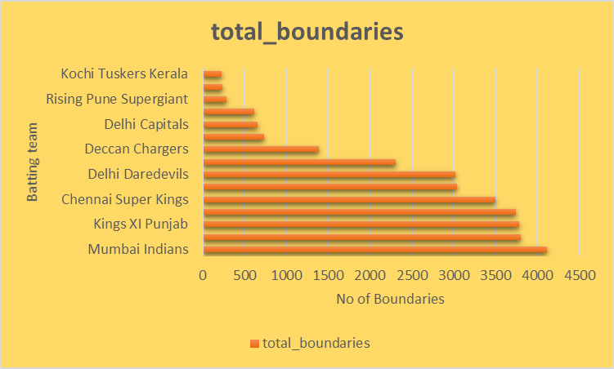
Chart Graph of Total Boundaries scored by each team

Slide 28
Q5.Write a query to fetch the total number of dot balls bowled by each team and order it in descending order of the total number of dot balls bowled.
select distinct bowling_team ,count(ball_result) as total_dot_balls
from deliveries_v02
where ball_result = 'dot'
group by bowling_team
order by total_dot_balls desc;

Slide 29
bowling_team | total_dot_balls
Mumbai Indians | 8714
Royal Challengers Bangalore | 7955
Kolkata Knight Riders | 7894
Kings XI Punjab | 7679
Chennai Super Kings | 7593
Rajasthan Royals | 6665
Delhi Daredevils | 6520
Sunrisers Hyderabad | 5248
Deccan Chargers | 3306
Pune Warriors | 1900
Delhi Capitals | 1338
Gujarat Lions | 1095
Rising Pune Supergiant | 698
Kochi Tuskers Kerala | 626
Rising Pune Supergiants | 539
NA | 71
Total No of Dot ball played by each team

Slide 30
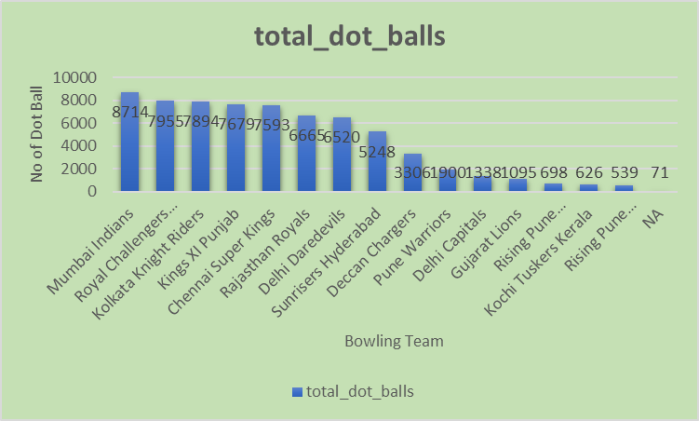
Chart Graph of Total Dotball played by each team

Slide 31
Q6.Write a query to fetch the total number of dismissals by dismissal kinds where dismissal kind is not NA
select dismissal_kind,count(dismissal_kind) as total_dismissals
from deliveries_v02
where dismissal_kind !='NA'
group by dismissal_kind;

Slide 32
Total no of Dismissals occured
dismissal_kind | total_dismissals
bowled | 1700
caught | 5743
caught and bowled | 269
hit wicket | 12
lbw | 571
obstructing the field | 2
retired hurt | 11
run out | 893
stumped | 294

Slide 33
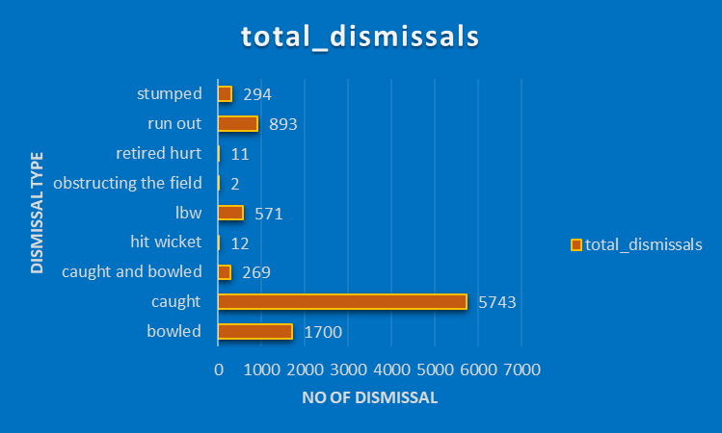
Chart Graph of TotalNo of Dismissal vs Dismissal type

Slide 34
Q7.Write a query to get the top 5 bowlers who conceded maximum extra runs from the deliveries table
select bowler,sum(extra_runs)as total_extra_runs
from deliveries_v02
group by bowler
order by total_extra_runs desc limit 5;

Slide 35
Total Extra run conceded By Top 5 player
bowler | total_extra_runs
SL Malinga | 293
P Kumar | 236
UT Yadav | 226
DJ Bravo | 210
B Kumar | 201

Slide 36
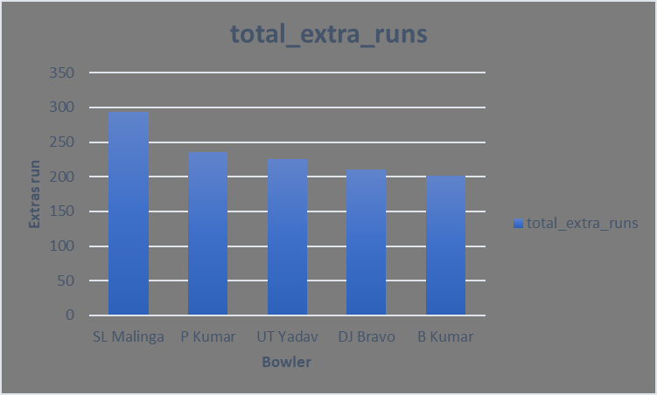
Chart Graph of Total extra run conceded by top % player

Slide 37
Q8.Write a query to create a table named deliveries_v03 with all the columns of deliveries_v02 table and two additional column (named venue and match_date) of venue and date from table matches
create table deliveries_v03 as (
select a.*, b.venue, b.date as match_date
from iplball as a
left join iplmatch as b on a.id= b.id );

Slide 38
Q9.Write a query to fetch the total runs scored for each venue and order it in the descending order of total runs scored.
select distinct venue , sum(total_runs) as total_runs_scored
from deliveries_v03
group by venue
order by total_run_scored desc;

Slide 39
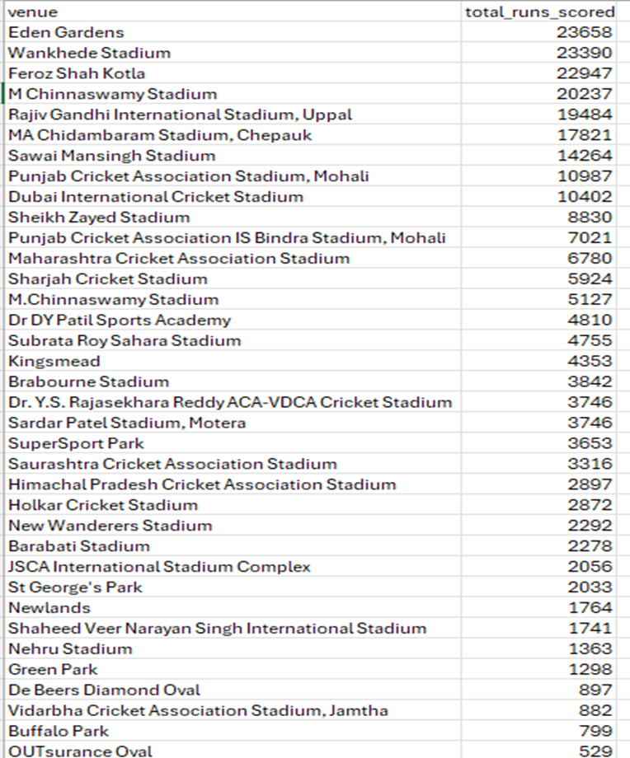
Total Runs Scored on Each Venue

Slide 40
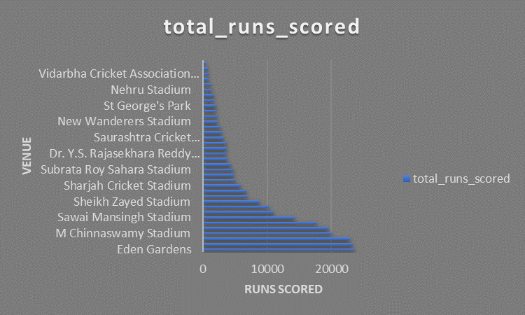
Chart Graph of Total Runs Scored Vs Each Venue

Slide 41
Q10.Write a query to fetch the year-wise total runs scored at Eden Gardens and order it in the descending order of total runs scored.
select
extract( year from match_date::DATE) as years,
sum(total_runs) as yearwise_total_runs
from deliveries_v03
where venue = 'Eden Gardens'
group by years
order by yearwise_total_runs desc;

Slide 42
Total Runs Scored on Eden Garden Venue on Year Wise
years | yearwise_total_runs
2018 | 2885
2019 | 2651
2015 | 2386
2013 | 2304
2017 | 2194
2010 | 2167
2016 | 2073
2012 | 2012
2011 | 1854
2008 | 1843
2014 | 1289

Slide 43
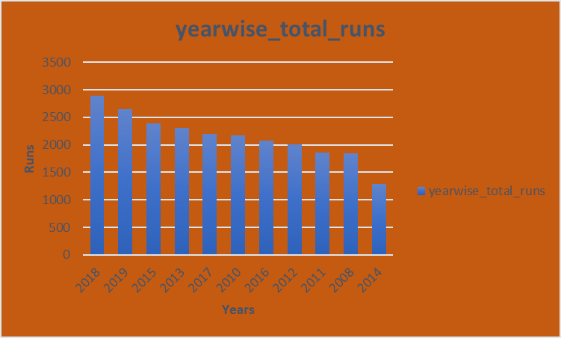
Chart Graph of Years Vs Runs

